Slide 1
Eye-tracking Figures: Jocamo, 03/31/2023
Compiled by Ethan J. Lott

Slide 2
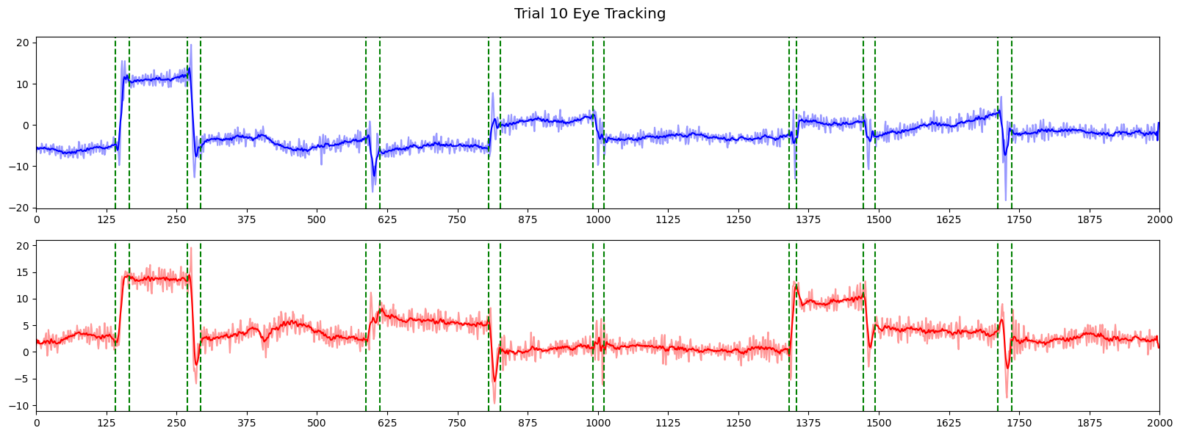
DPI Eye-tracking; Trial 10
x
y

Slide 3
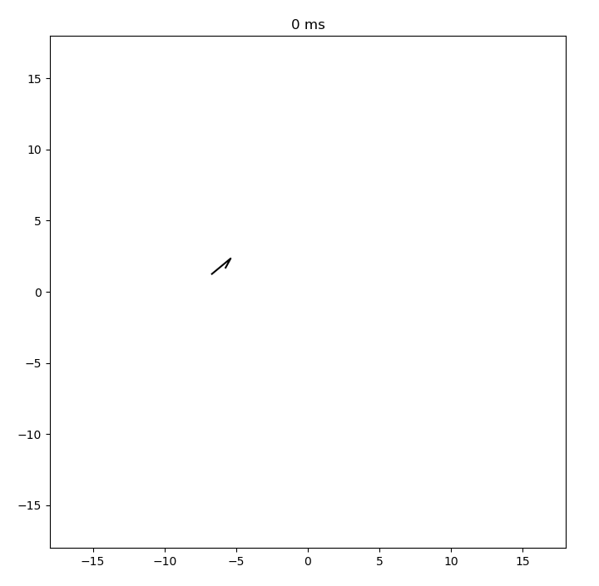
DPI Eye-tracking; Trial 10

Slide 4
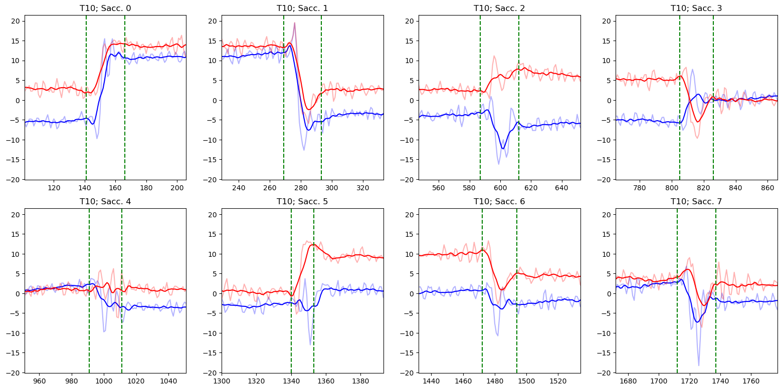
Individual Saccades; Trial 10

Slide 5
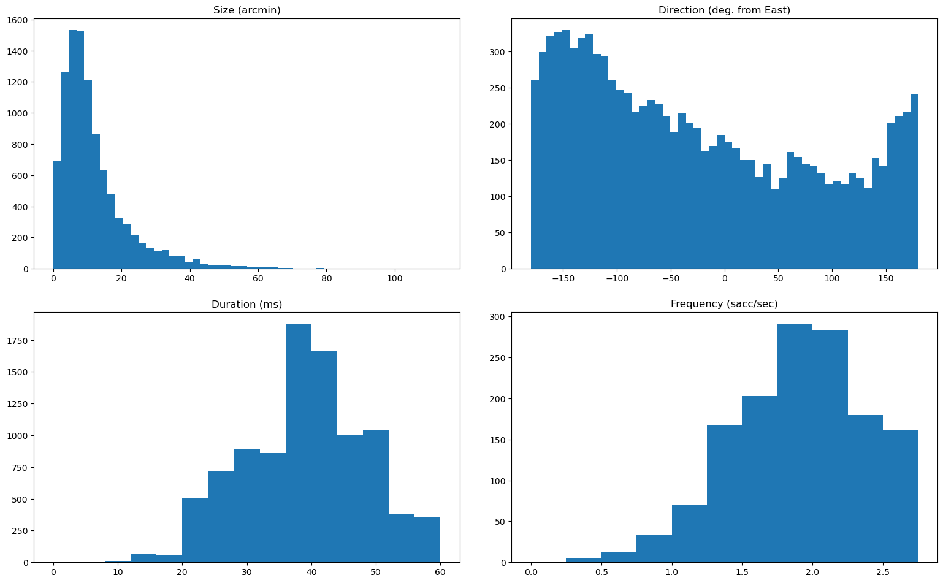
Saccade Statistics; All Trials

Slide 6
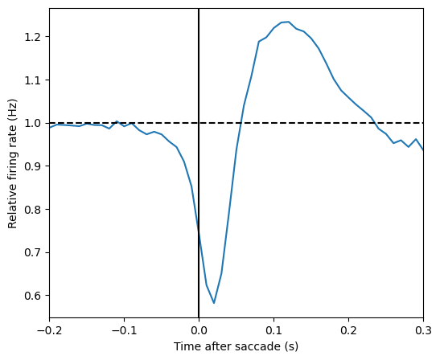
Average saccade kernel

Slide 7
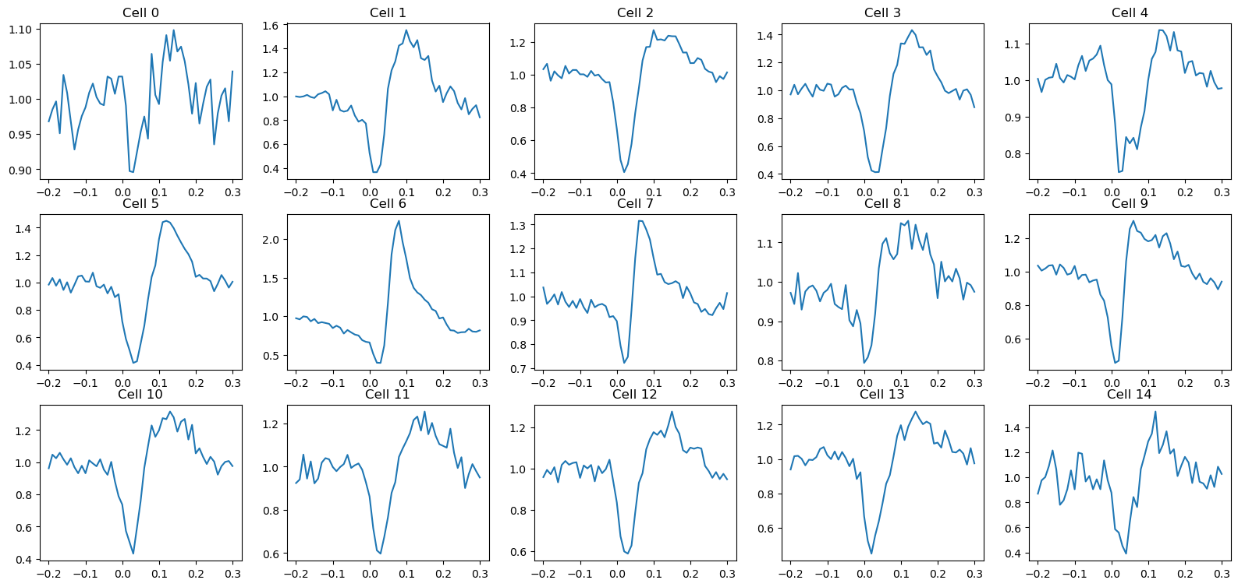
Ex. individual saccade kernels

Slide 8
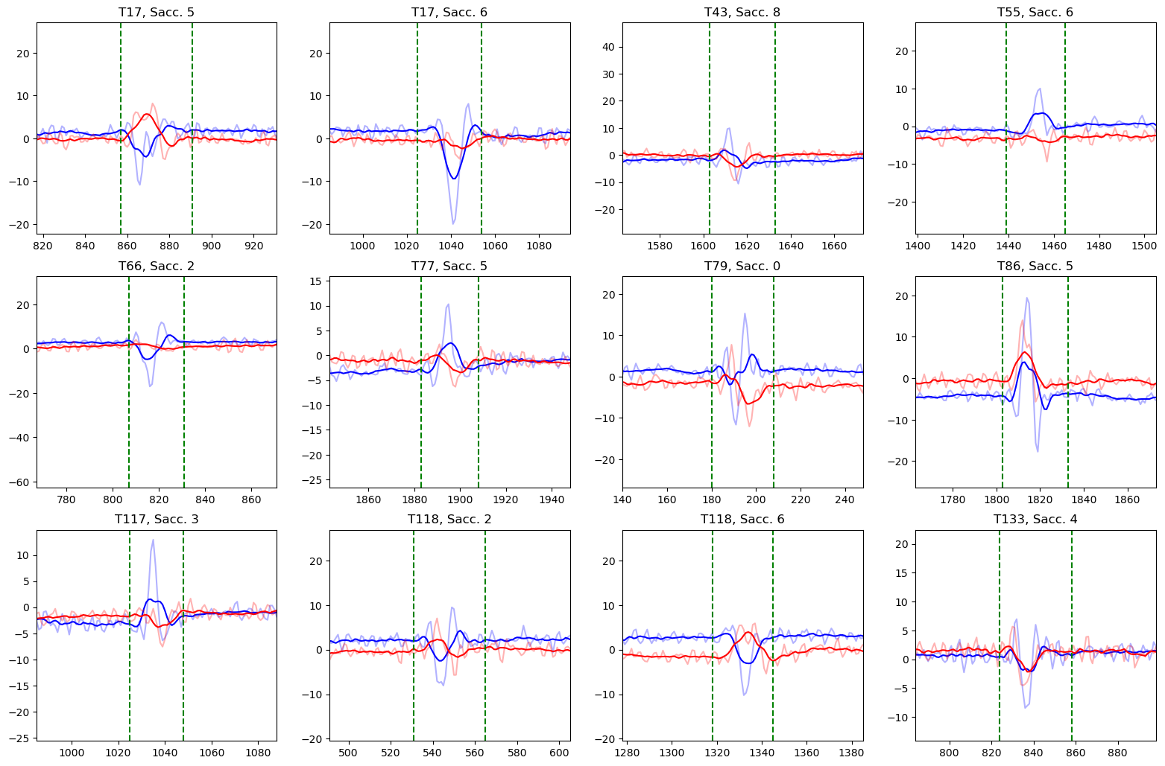
Saccade examples with <1 arcmin disp.

Slide 9
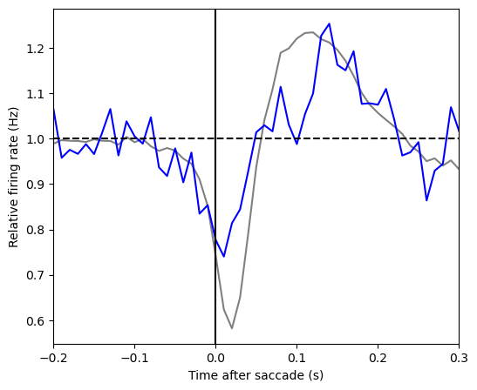
Average saccade kernel (<1 arcmin disp.)

Slide 10
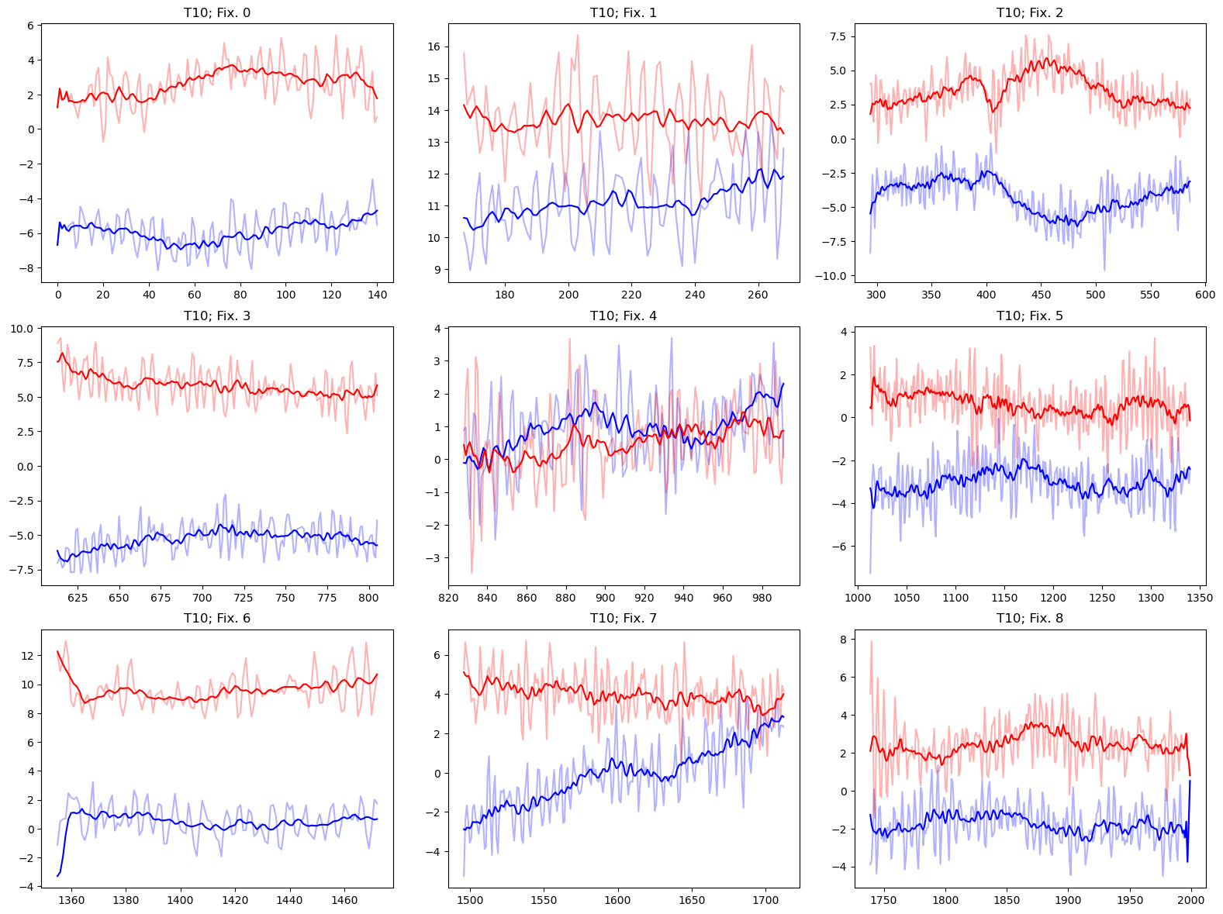
Individual Fixations; Trial 10

Slide 11
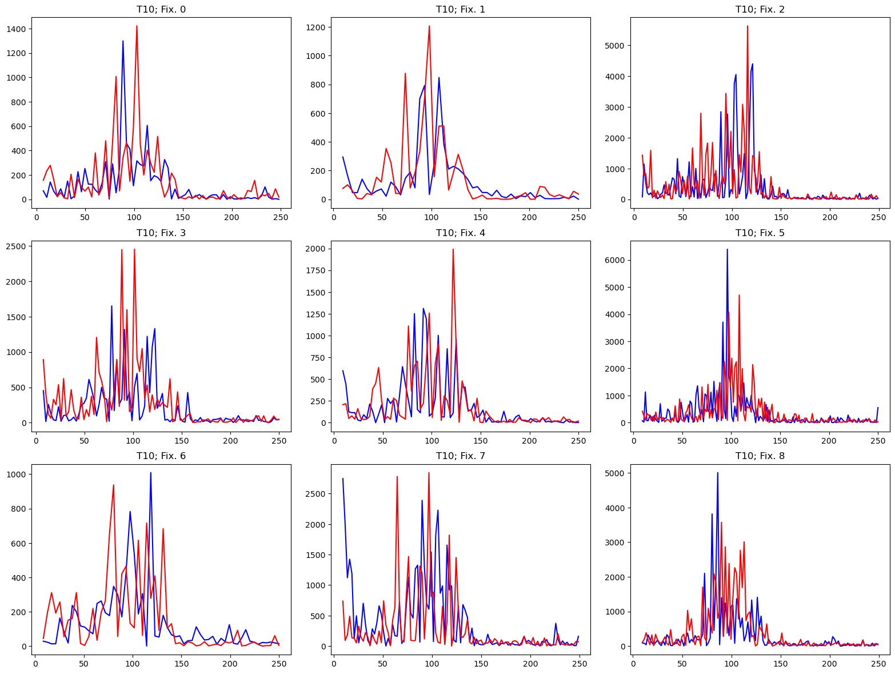
Freq. Spectra Of Fixations; Trial 10

Slide 12
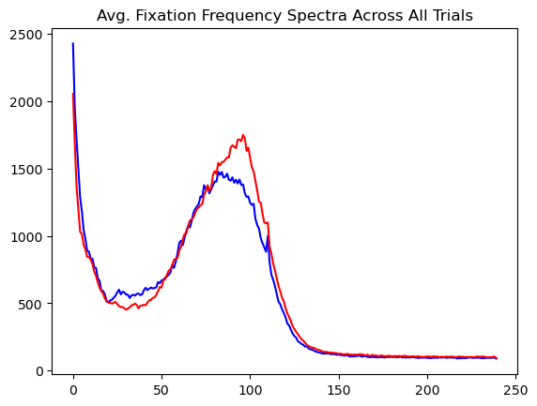
Avg. Freq. Spectra Of Fixations

Slide 13
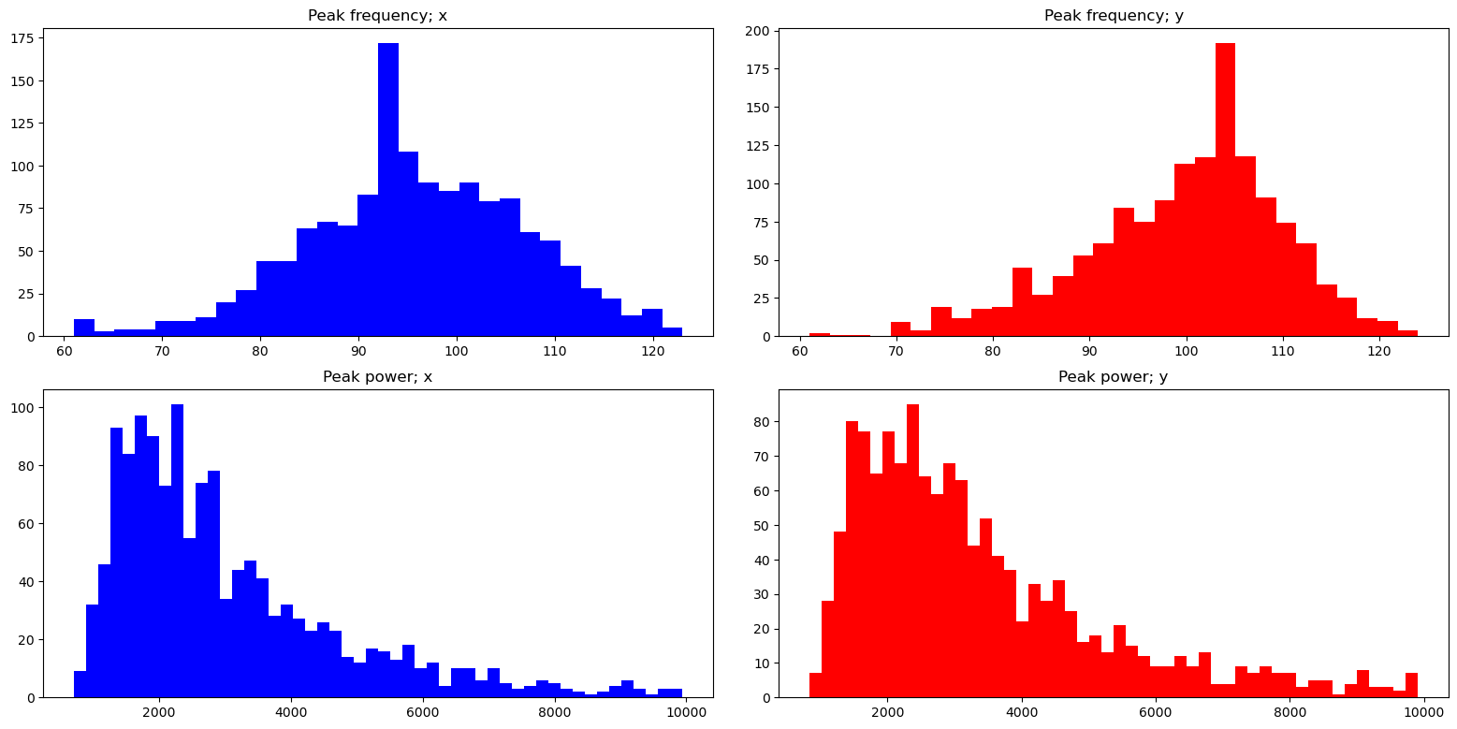
Peak Freq./Power Of Fixations

Slide 14
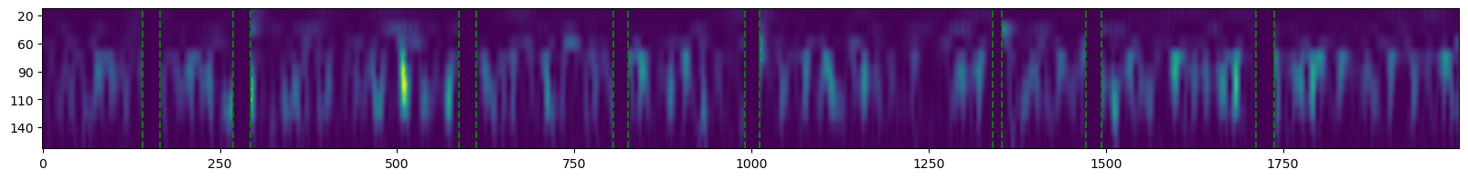
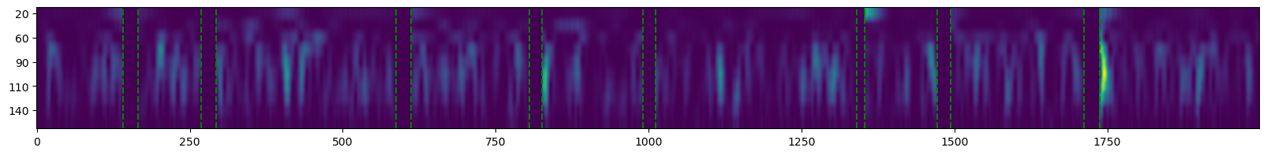
Wavelet Decompositions; Trial 10
x
y
x
y

Slide 15
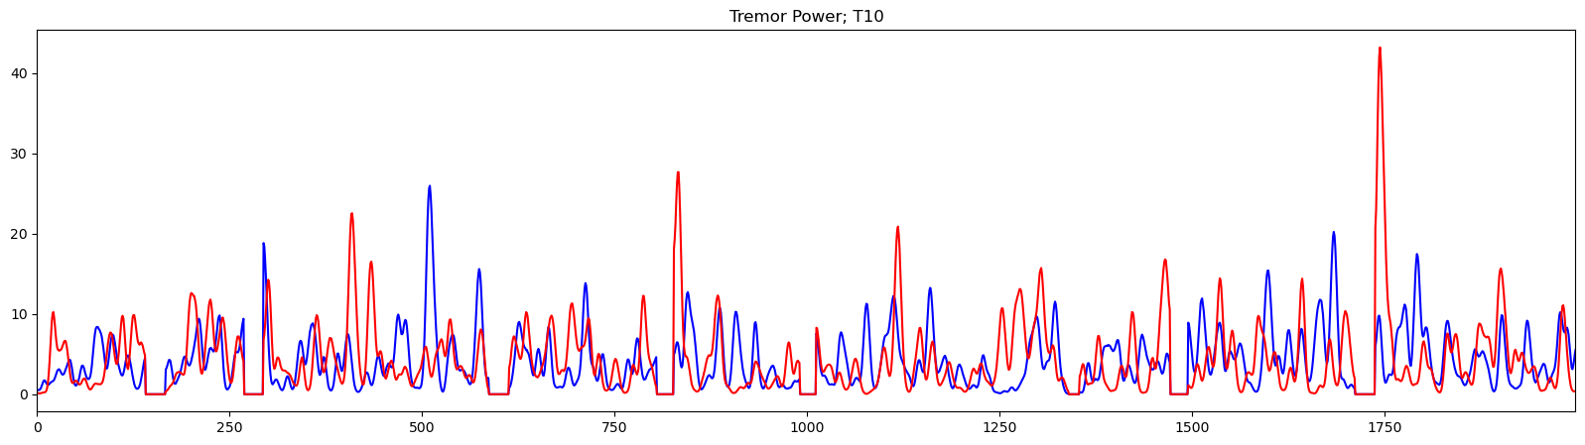
Tremor Power; Trial 10

Slide 16
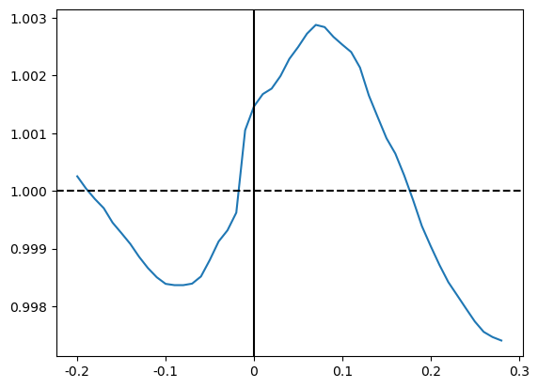
Tremor Kernel

Slide 17
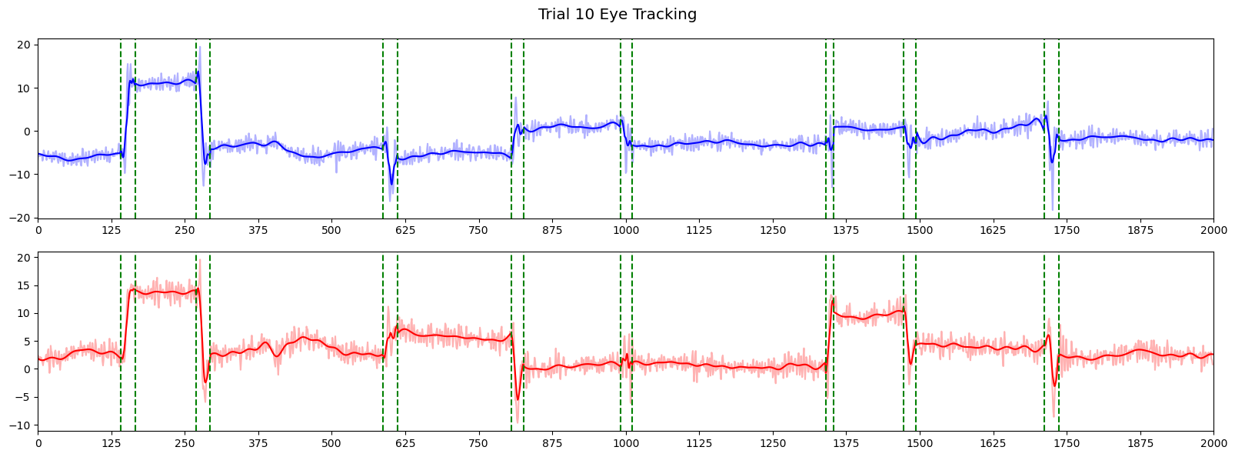
Filtered Eye-tracking; Trial 10

Slide 18
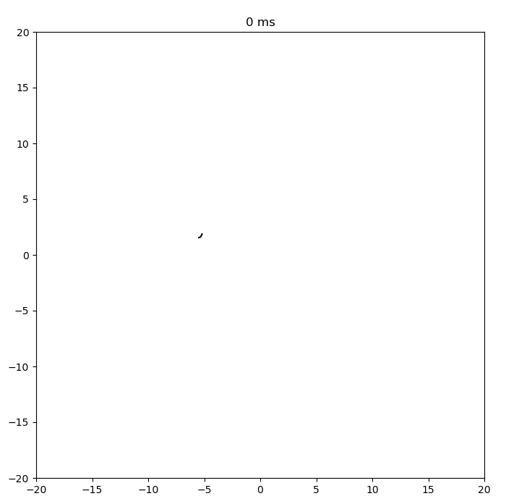
Filtered Eye-tracking; Trial 10

Slide 19
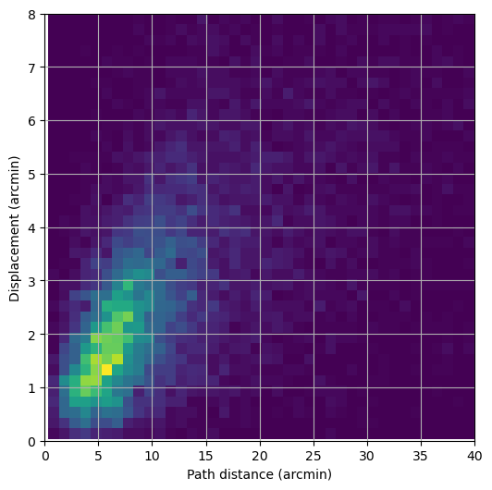
Ocular Drift Distance vs. Displacement

Slide 20
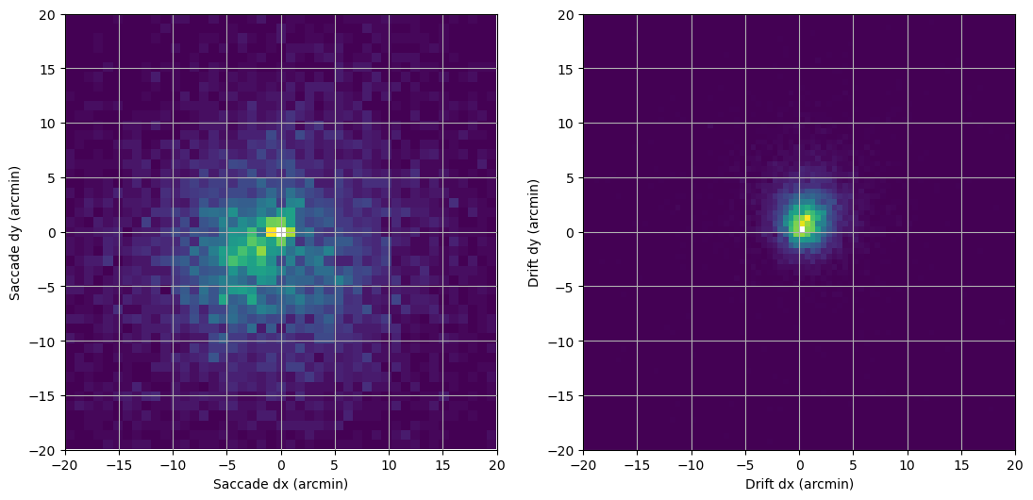
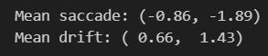
Saccade and Drift Displacement

